Slide 1
Project space walk
Software Construction-II
Professor – dr. Micheal findler
Sri himaja korrapati
1810548
05/14/2019

Slide 2
introduction
Project Space Walk is game mission where astronaut travels from one planet to other planet and take picture of that particular planet.
It contains 2 levels:
All the planets will be revolving around the sun with the same speed along with their orbit.
The astronaut need to travel from earth to mercury- take a picture, travel from mercury to Saturn- take a picture and fly back to earth.

Slide 3
Design
Classes used
Audio Manager()
ObjectOriented Camera()
Planet()
Capture Sequence Level object()
Character()
Input_keylistener()
Input_mouse()
Mission()
Player Controller()
Main Menu()
Isequence Controller()

Slide 4

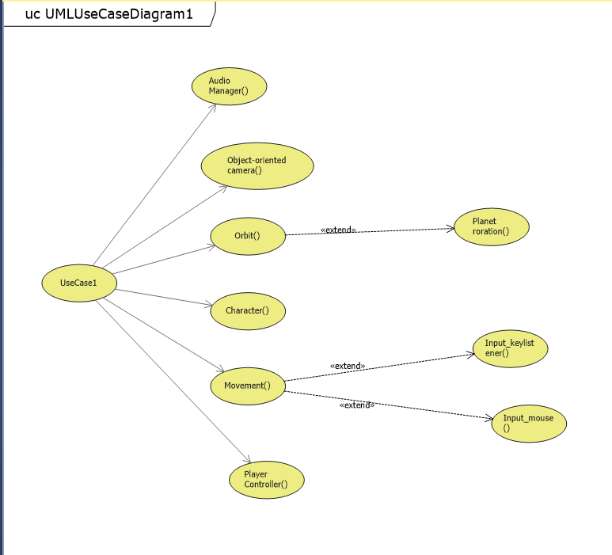

Slide 5

Refactoring
Code Refactoring is the way to re-structure the existing code.
In this project I have re-structured the code using level-1 code.
Cyclomatic complexity : E – N + 2* P
Where,
E – no . of edges
N - no . Of nodes
P – no . Of nodes that have exit points.

Slide 6
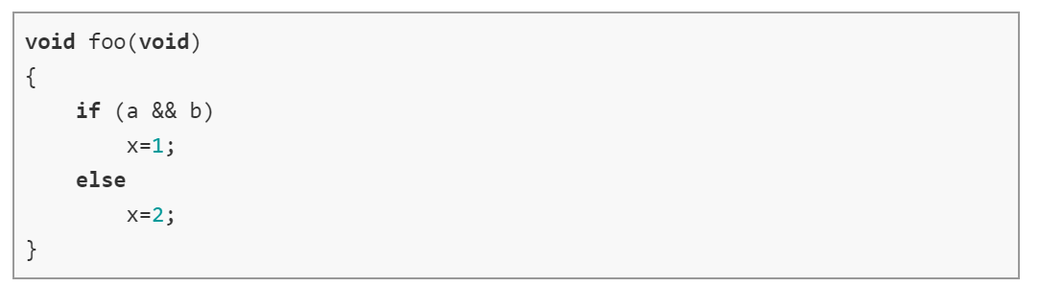
Example
In the above, we could see only 1 decision. So the cyclomatic complexity is 2.

Slide 7
summary
Designed level 2 code using level 1
Unit testing running independently with module, functions and classes
I have created planets revolving around the sun in their orbit with the same speed.
Committing in github.

